Slide 1
Fantasy Hacks
Hack your fantasy league!

Slide 2
Purpose
To help people predict what a player will do on a given night against a given team
Mostly for fantasy sports or gambling

Slide 3
Income
We will charge a X amount of money for the use of our site. People will have to subscribe to use an account.
There will be no free version nor ads to attempt to have a more professional and creditable look
Our only costs are man power + hosting. All stats we use are public knowledge

Slide 4
Future
Right now we use a current formula which doesn’t take into account very rare occurrences. For instance a ball going out of bounds off a miss shot rather than being rebounded
Injury formula could be added to predict a injury chance of a player along wit adjusting predictions based off new injuries to a team. For instances Jimmy Butler being injured would likely increase the amount of points Dwayne Wade
Other sports like baseball and football can be added

Slide 5
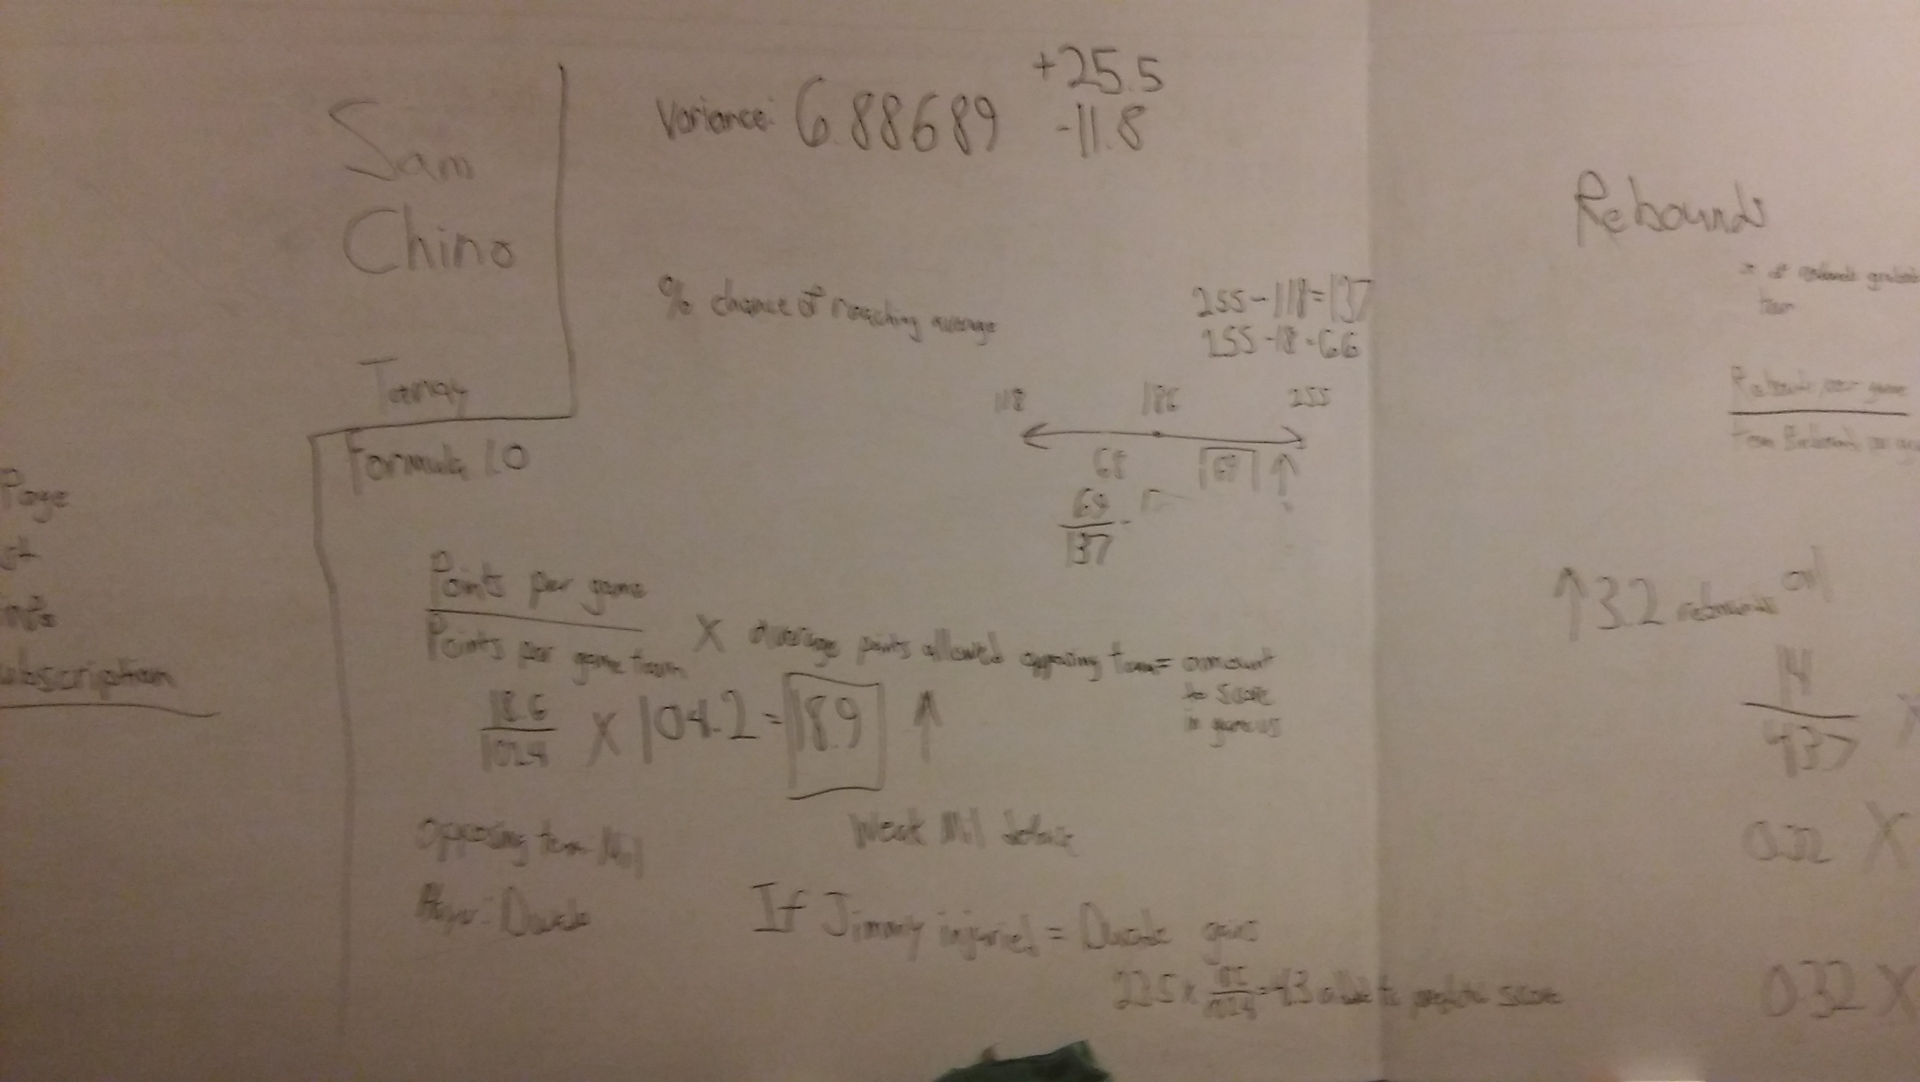
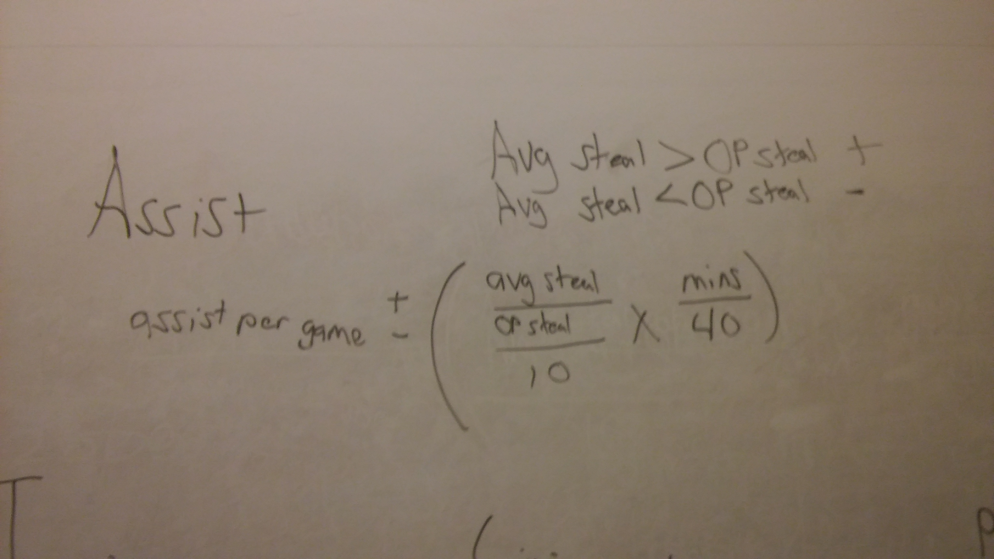
Formulas
Points Formula
Assist Formula

Slide 6
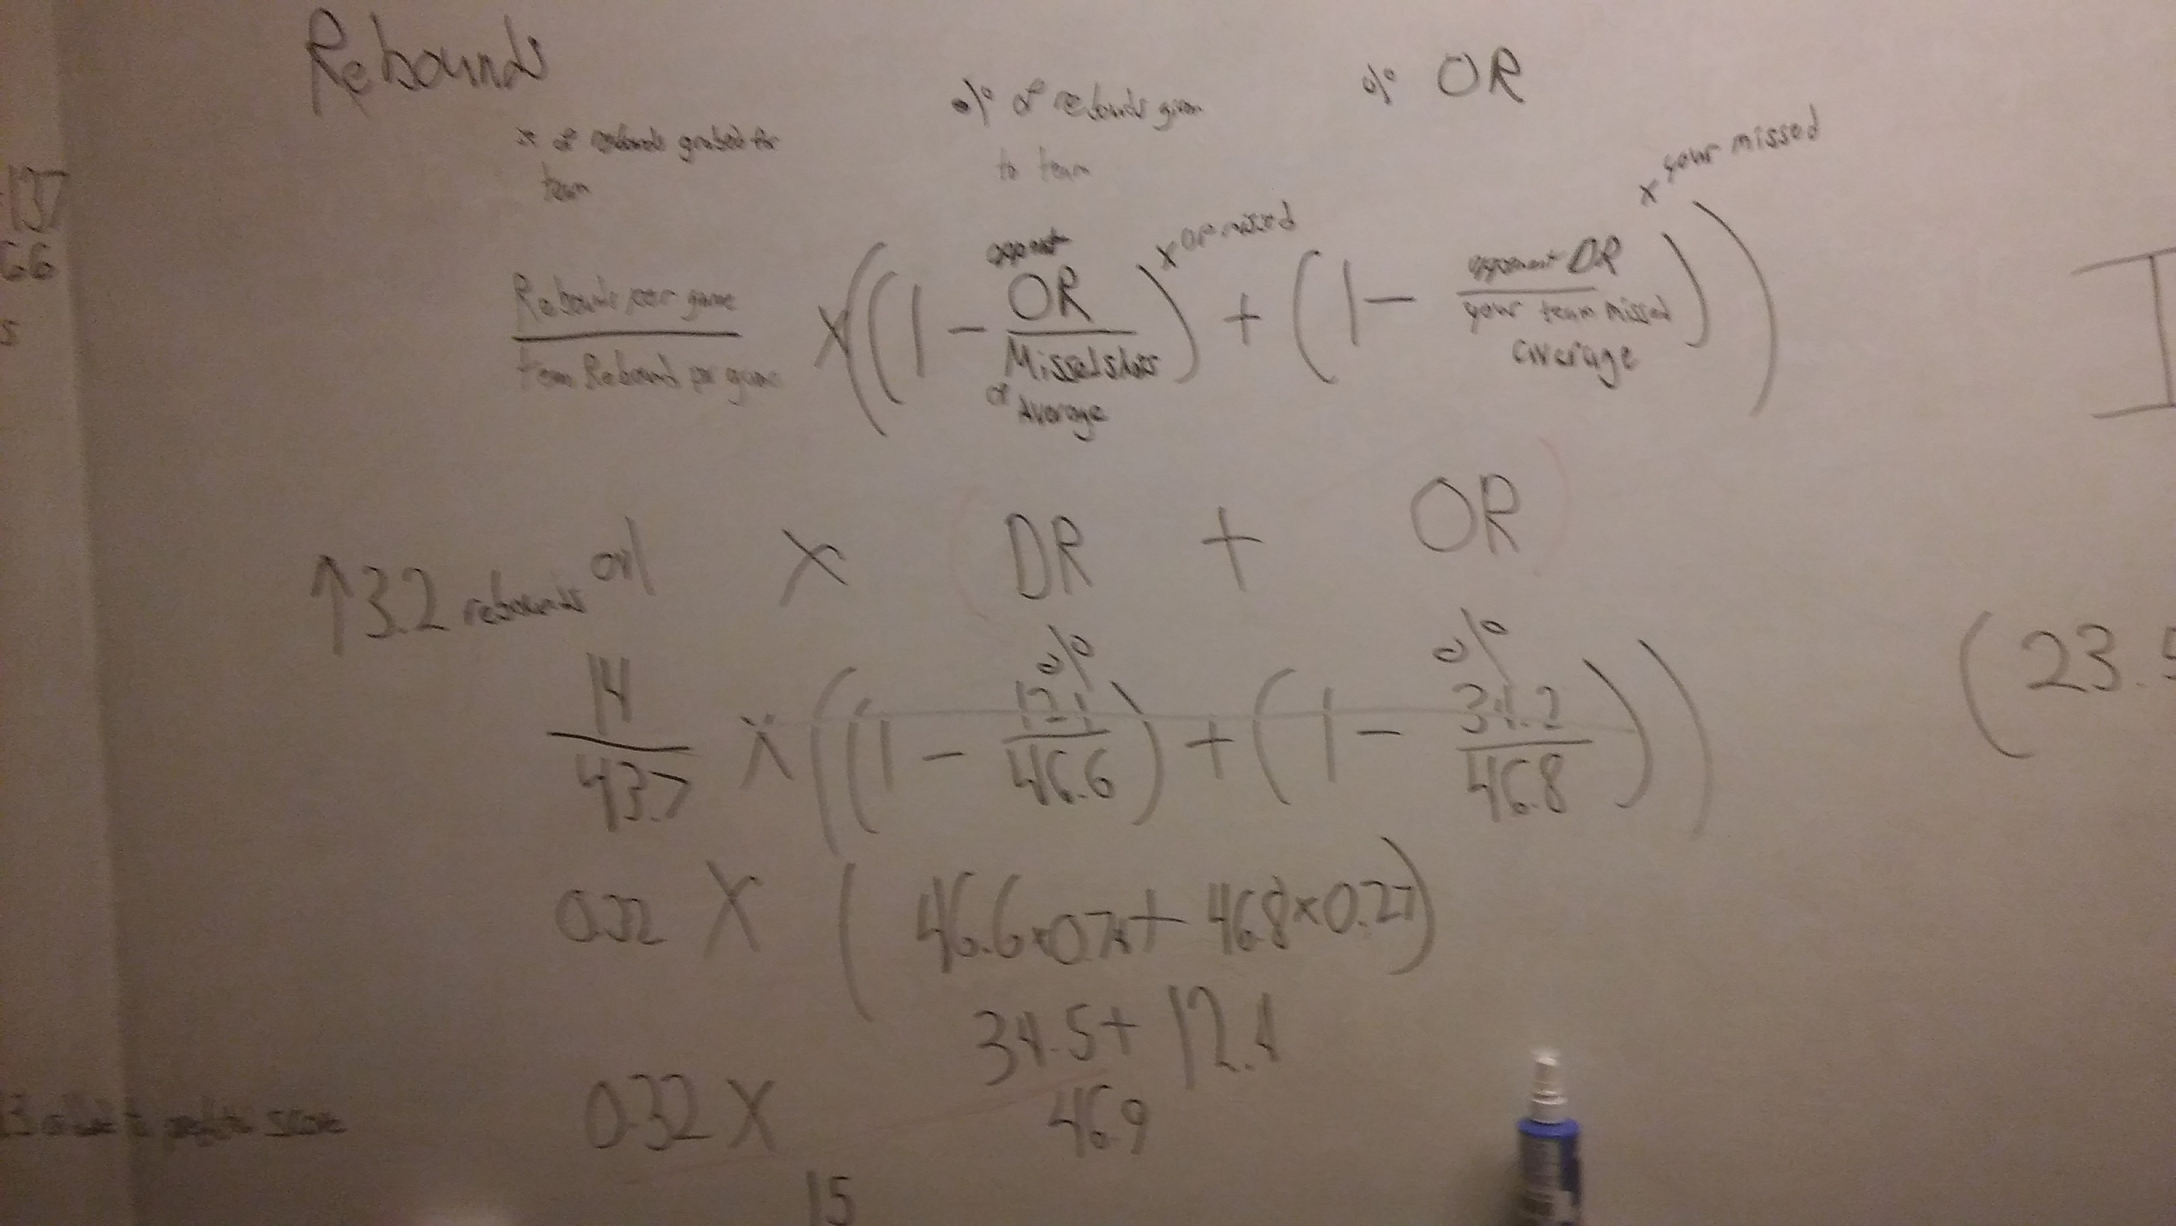
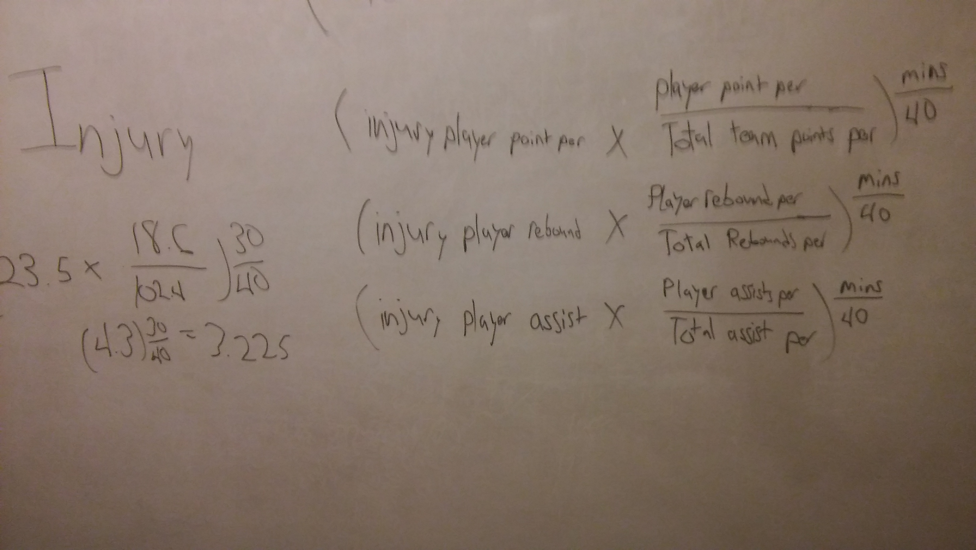
formulas
Rebound formula
Injury adjustment formula

